Slide 1
Analysis and Training of FIFA19 Dataset
By: Hardik dhayal
02316404518, MCA(SE), Sem IV

Slide 2
Inspiration and problem statement
Sport analytics as a branch is getting more and more recognition for the improvement of all physical sports ranging from football to cricket to basketball to athletics.
We now have vast repositories of statistics and data points all over the internet which has made it possible to find intricate details that could help the individuals or the teams as whole to get better.
One of such data repository is the FIFA19 dataset which could potentially provide a ton of new information through proper analysis. The analysis could help the coaches, the managers, the players with their plans and serve as an interesting insight for the fans around the globe.
Proper Visualization and Learning is required to extract the insights from the Dataset, and that is the aim of this project.

Slide 3
Process steps
Reading the Data: Creating a pandas DataFrame which forms the base for all other operations to be done over it.
head and describe functions to get a bigger picture and understand the range of values of the data entries.
Dealing with unnecessary features and missing value:
Check for missing values in columns where missing values is more than half of the total number of values and Dropping column based on this condition.
Filling the missing value for the continuous variables for proper data visualization.
Plotting of graphs: Graphs like bar plots, Violin plot, polar projections, scatter plot, count plot.
Classification of Players into their Respective position:
Remove Missing Values
Standardize the data
Splitting data into train and test set
Making a Neural network with 2 hidden layers using Keras.
Training the data
Checking accuracy and other Metrics

Slide 4
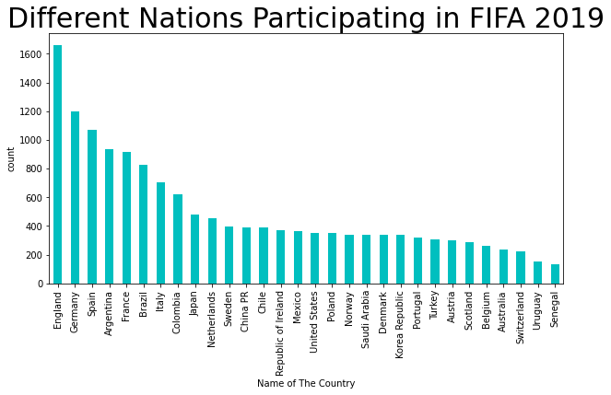
BAR Plot
This is a bar plot showing the count of players from 30 countries which are in the dataset.
We can observe that European countries produce the maximum number of players which go on to play for top clubs, followed by South American countries.
England tops the chart with more than 1600 active players in the top clubs all over the world.

Slide 5
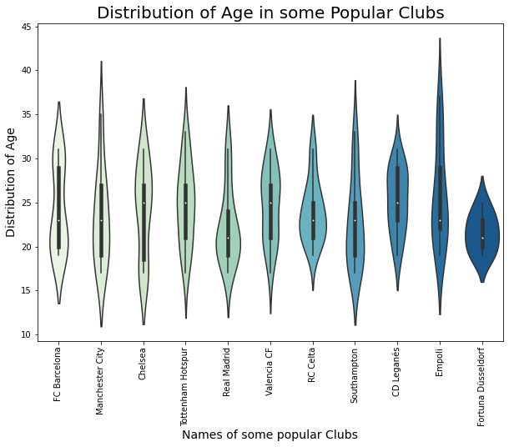
Violin Plot
It is a distribution plot which shows density of data at different values.
The thickness of plot at the corresponding age value shows the density of players of that age present in the club.
The Tiny dot in the middle is the median.
We observe Empoli has some players up to the age of 44 whereas the players in Fortuna Düsseldorf are mostly youngsters with average age of 20-25

Slide 6
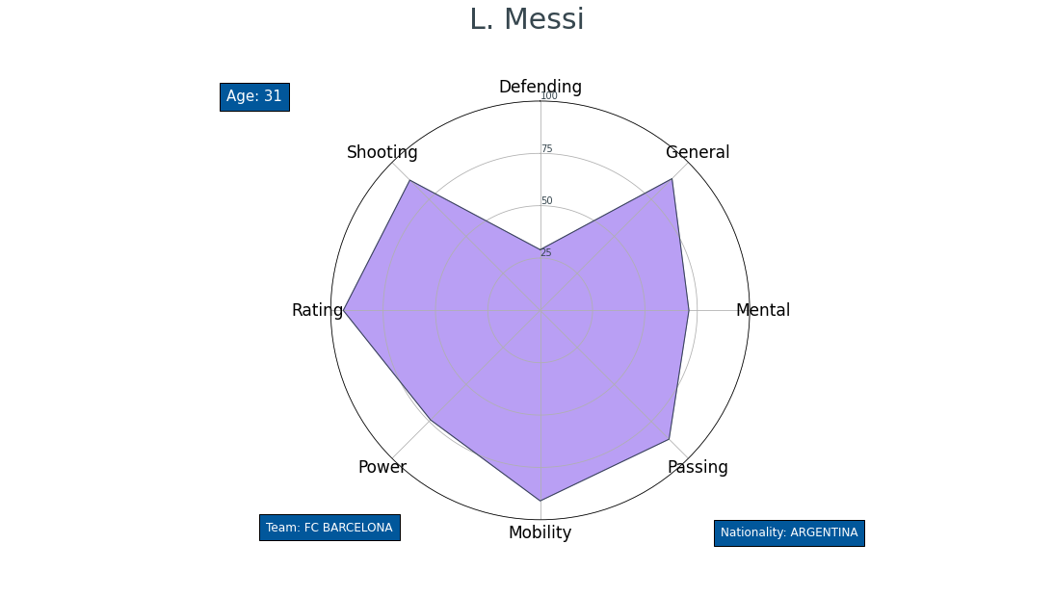
Polar graph
A polar curve is a shape constructed using the polar coordinate system. Polar curves are defined by points that are a variable distance from the origin depending on the angle measured off the positive xx-axis.
Here we have 8 polar points corresponding to 8 important attributes like Defending, shooting, Mental, Passing, Power, Mobility, Rating, General shown simultaneously for a particular player.
The origin has the lowest value of 0 and then we have concentric increases of 25 up to 100 as it moves away from the center.
This is the polar graph of Lionel Messi who is a forward hence high values of Shooting, Passing, Mobility whereas lower value for defending.

Slide 7
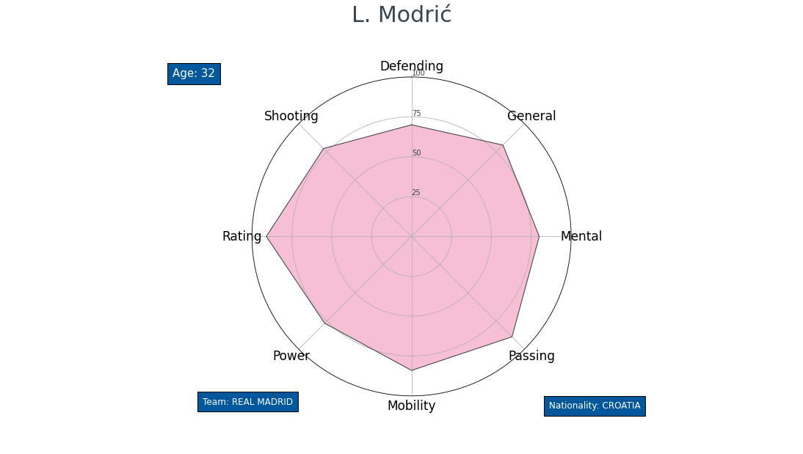
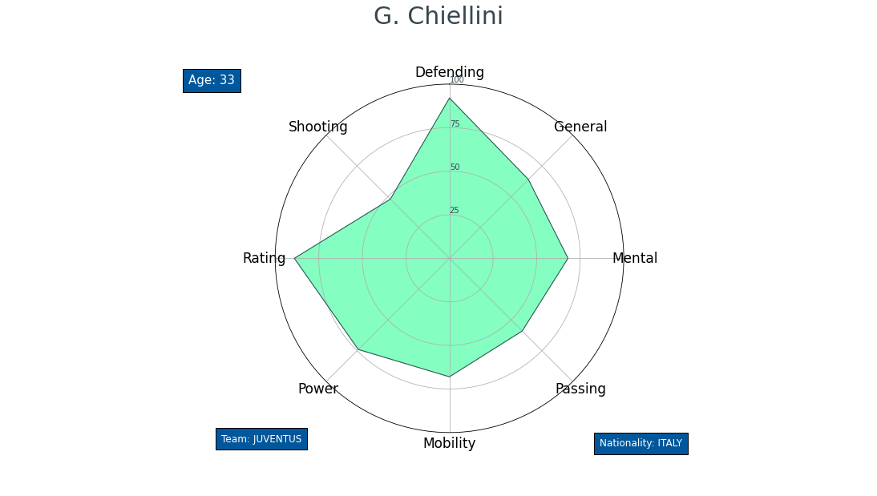
Luka Modric is a midfielder hence his defending attributes as are good as his attacking attributes
Giorgio chiellini is a Defender hence his passing, shooting, mobility is not as important as his defending attribute.
Both of above mentioned players play on complete different positions but still have the Rating value as high which shows that both are world class player at their position.

Slide 8
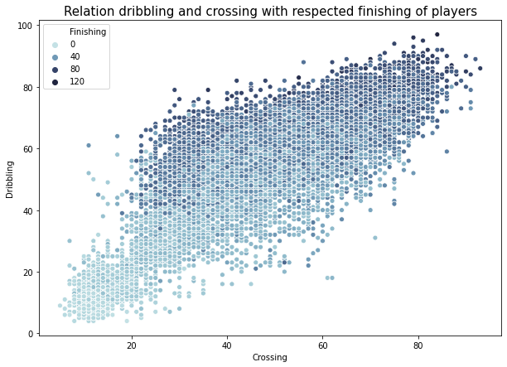
Scatter Plot
Scatter plot can show correlation between two variable on x-y plane
Another variable can be added to the graph using color with varying hue level.
Here we see the correlation between Dribbling, Crossing and Finishing
We observe that players with better dribbling( over 60 ) also have high finishing attribute( dark blue ) which shows a strong correlation but same cannot be said about crossing and finishing.
A good finisher will be a good dribbler but we can’t infer whether a good finisher will be a good crosser or not .

Slide 9
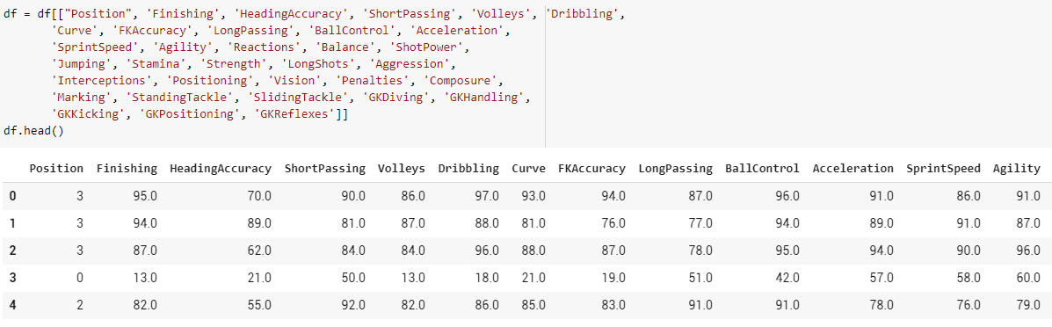
Classifying players on basis of position
These 33 attributes were used for classification of Players into the 4 positions: Goalkeeper, Defender, Midfielder, Forward.

Slide 10
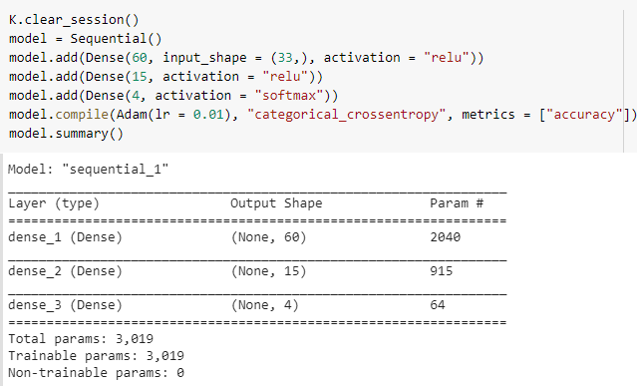
Model architecture

Slide 11
We have the input layer with 33 attributes, two hidden layers with 60 and 15 neurons respectively, and the output layer with 4 neuron for each class position.
Parameters can be calculated as follows:
33*60 + 60 = 2040
60*15 + 15 = 915
15*4 + 4 = 64
Total parameters : 3019
The optimization algorithm used is Adam.
Adam is a variation of gradient descent which uses momentum based techniques and adaptive learning techniques to quickly reach the minima of loss function.
In momentum bases gradient descent, we take into consideration previous gd as well as the current one. If the previous once pointed towards one direction then its value will keep increasing and it will move faster through flat regions
In adaptive learning we increase or decrease the learning rate of individual parameter according to weather that parameter is being updated frequently or not. It they update frequency we decrease their learning rate but if they are sparsely updated we increase their learning rate.

Slide 12
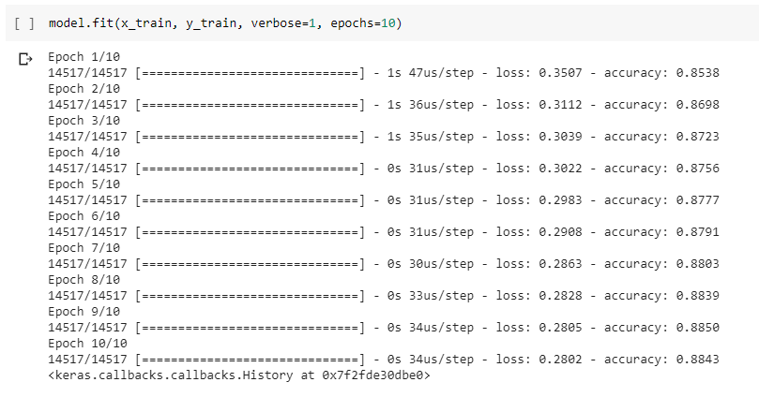
Results of training
As the model trains and starts manipulating the neurons we can observes the loss is decreasing and accuracy is increasing, which shows that the model is indeed learning.
The final accuracy after 10 epochs comes out to be 0.8843.

Slide 13
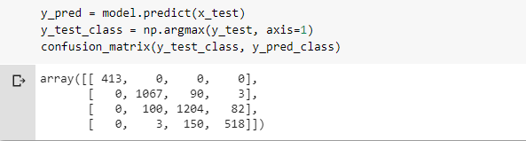
The Confusion matrix shows the True Label vs. Predicted Label for all the 4 classes of Goalkeeper, Defender, Midfielder, Forward.
The elements on the Diagonal (413, 1067, 1204, 518) are the correctly predicted values whereas every other element outside the diagonal show the inaccuracy between the True label and predicted value.

